Slide 1
ENSE 400 Bi-Weekly Scrum Report-Out #2
ZAM
Zain Abedin . Alwin Baby . Muhammad Ahmed

Slide 2
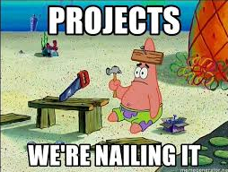
Project deats
Remind me what you are doing
Web application platform for Lab Safety, Training and Inspection.
One platform to manage equipments, safety hazard info , training manuals/videos, inspection management process
Other softwares lack integration, features not specific to the academic industry, expensive

Slide 3

Project & documentation review
What are you currently working on?
User stories
User Stories
Wireframes for Safety Coordinators
Students And Instructors wireframes Wireframes
Picturing (software) architecture documentation/work
Asana
Requirements Document <Link>
Code
Exploring Laravel PHP Framework
None Available
Testing plans/work
None Available
Deployment/change management plan/work
Asana
Maintenance & refactoring plan/work
None Available
GitHub/Version control “stamp of approval”

Slide 4

Group reflection
Do you feel you are on track?
Yes, we think we are on track
Asana - for project management(task assignment, milestones ,etc.)
Do you feel there are barriers to your success (if any)?
Other classes
Limited time to learn new framework, tech stack
Do you need any help going forward?
We need hosting solution
Possible review of architecture once solution is
modelled

Slide 5
Questions?

